Slide 1
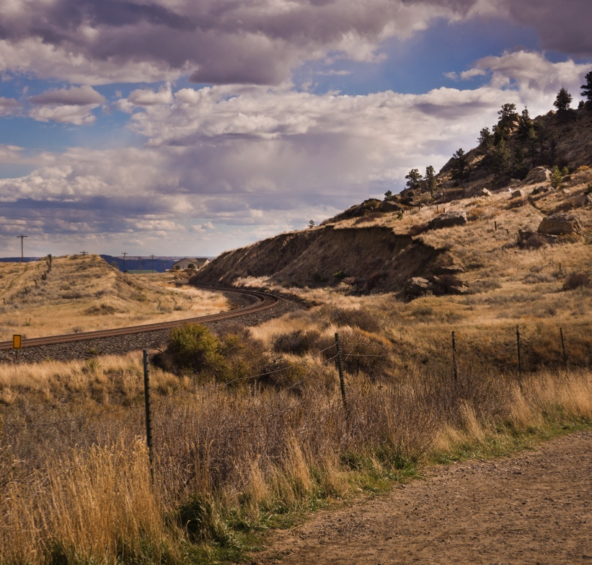


MT → OR → WI
Notes:
Hi. I’m Jared Knowles. I’m a social scientist. I was born and raised in Montana, went to college in Oregon, did my graduate work in Wisconsin while working for the state government. I am an open source developer specializing in statistical learning and the R programming language. I’m also an avid amateur photographer, and all of the photos are mine.

Slide 2
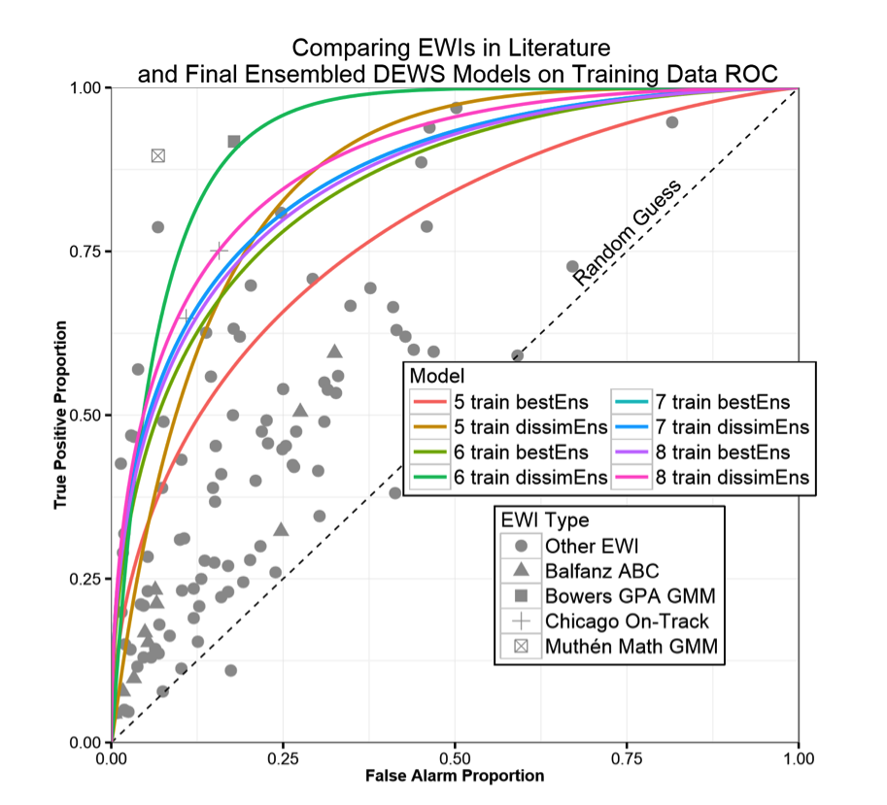
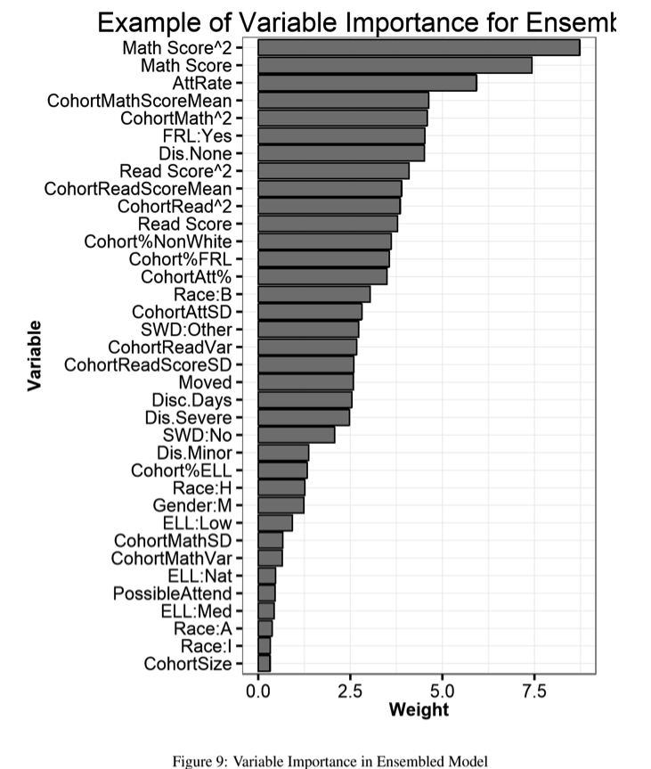
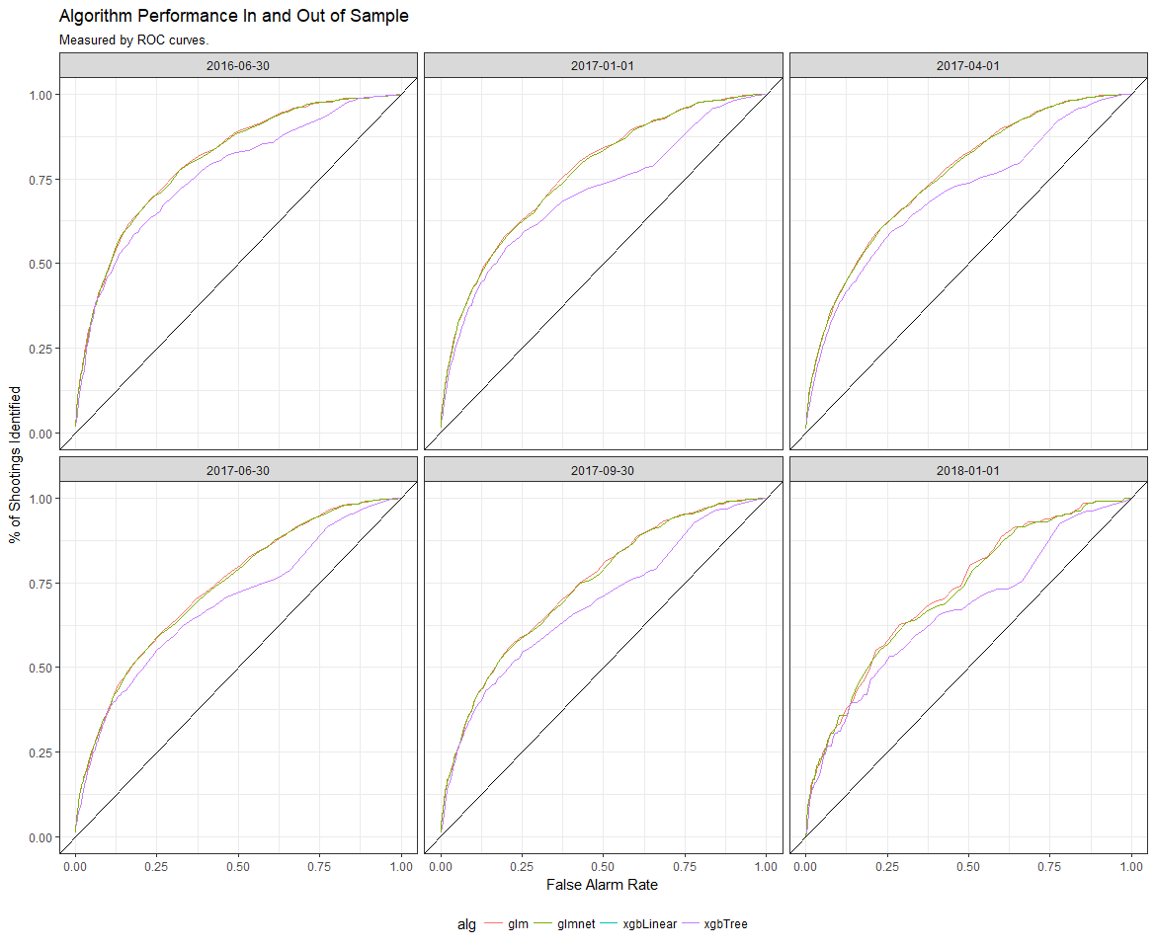
Open Analytics
Wisconsin Dropout Early Warning System (DEWS)
Notes:
I got started with open because it philosophically aligned with my job at the Wisconsin education agency – I was tasked with building statistical models to help aide decision makers at the local and state level. Open source allowed me to do that in a way that I could leverage my expertise and build the right model for the right job, but also retain the open transparency required to collaborate and remain responsive to other branches of government, the public, and stakeholders.
While in Wisconsin I built the first machine learning early warning system for an entire state – the Wisconsin DEWS. I open sourced all of the code and ideas behind this system so that others could learn, understand, and refine it. It’s still in place today.

Slide 3

Boston, MA
Civilytics Consulting
Public, transparent, open source analytics
Notes:
As I worked in education I became interested in the widening gap between what served as evidence in policy discussions – data rich, reliant on internal metrics and figures – and what was available to the public. I founded Civilytics Consulting upon a move to the Boston area to pursue this interest in education and other policy spaces.

Slide 4

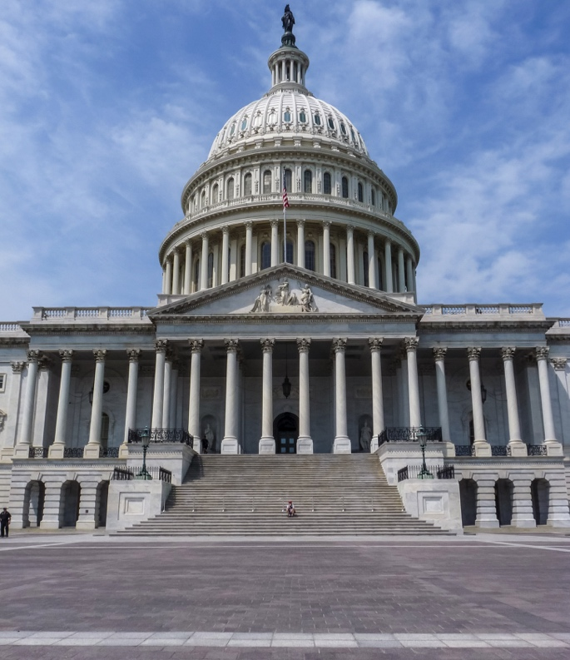
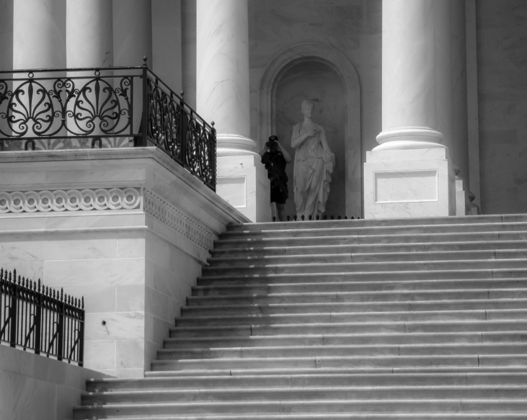
the democratic dilemma
For democratic accountability the public and government must reason with and use the same metrics
Data & analytics = increasing exclusion of citizens
Government agencies won’t close this gap
Comparability is key
Notes:
Openness is at the core of one of the fundamental social challenges of our time – the tension between the need for expertise, and democratic decision making.
For the public to hold the government accountable, the vocabulary of government officials and the public must largely be the same – but as government takes on more complex and specialized challenges, technical expertise drives the conversation inside of government, and citizens cannot participate as non-experts.
In good times, agencies may seek to boost their credibility by voluntarily submitting to publicly accessible, comparable, performance metrics that the agency also uses. In normal or bad times, agencies will obfuscate, block, discredit, or obscure this information to avoid accountability and resist public pressure.
Comparative performance metrics are the only answer, built on open and audited data, in a completely transparent way, in a third space between citizens and the government.

Slide 5
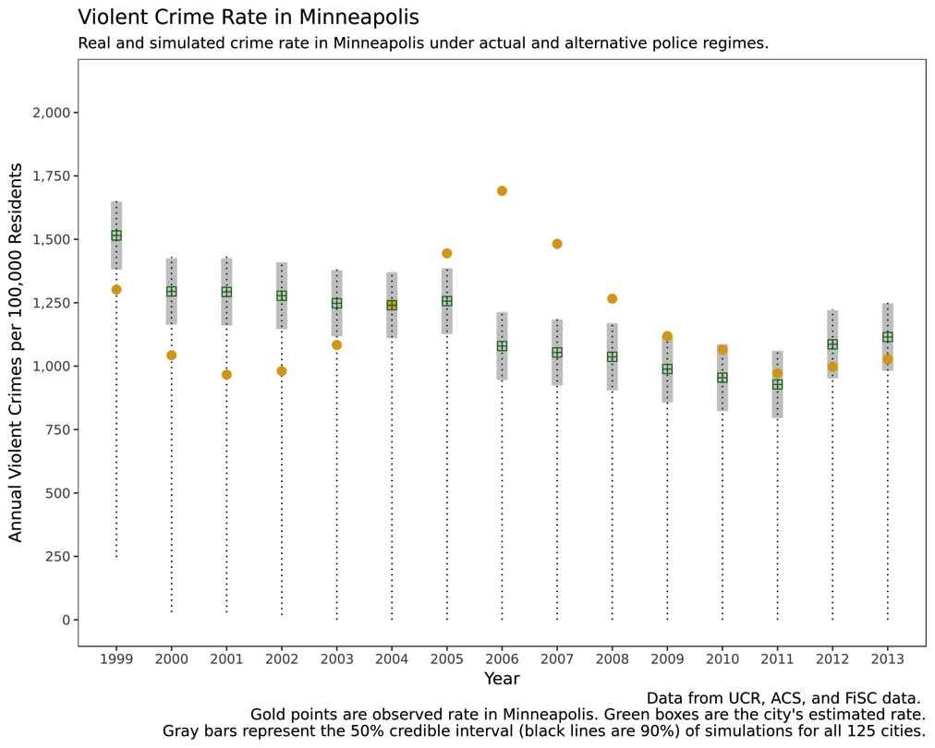
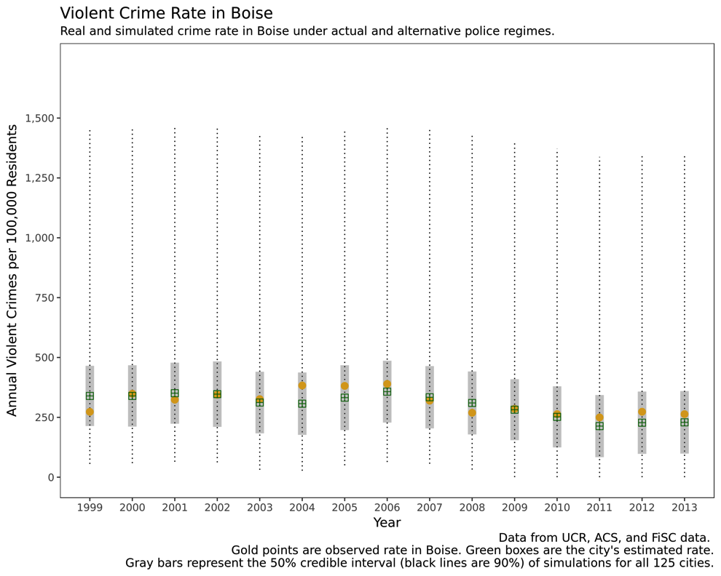
Open Analytics in Policing
Compare police outcomes to other police departments
Adjust for research-based factors (demographics, economic conditions, prior crime rates)
Identify high and low deviance departments
Notes:
Here’s an example of how this could look, in a policy area that has so far resisted comparative performance metrics – policing.
Using an open federal data collection on crime in each police department’s jurisdiction we can estimate the expected crime rate for a city.
Then, we can look at the expected crime rate for any city under the hypothetical jurisdiction of any police department, and see how well police departments do compared to peers policing a city with the same socio-economic conditions.
These two charts show Boise and Minneapolis respectively and we can see that the observed (dots) values of Minneapolis and expected values (gray bars) of MN are at the high end of the expected violent crime rate for all police departments nationally – the Minneapolis PD seems to underperform.
Boise, on the other hand, has much lower observed and expected crime rates under the Boise PD than we would expect. Boise overperforms.
An analytic metric like this is not an answer, but a beginning. It advances the debate from unadjusted means to more refined questions in an open and transparent way. You should be able to fork, modify, design, and publish your own alternative analytics – perhaps I didn’t control enough for religiosity – and the inquiry into this difference should deepen.
And citizens should be empowered to engage their public officials in these kind of questions, at a local level, armed with the knowledge and wisdom of trusted analytics reviewed and used by many in an open and transparent community.

